Slide 1

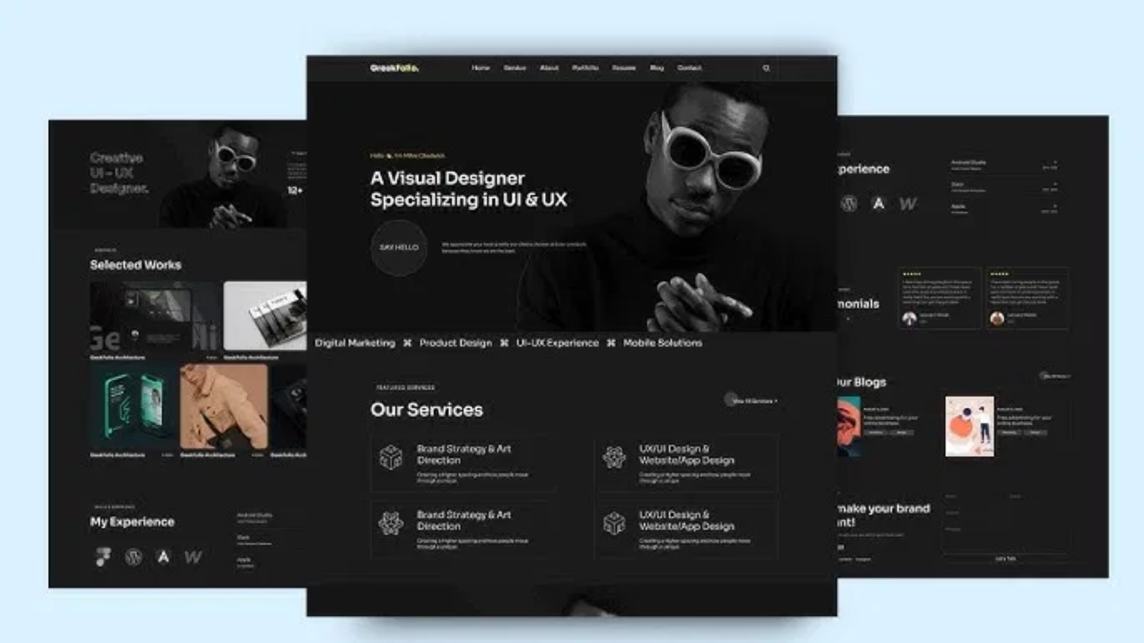
Abdallah Mohammed Elmahdy
Portfolio Application Showcase
A Modern Full-Stack Developer Portfolio
AE
Portfolio

Slide 2

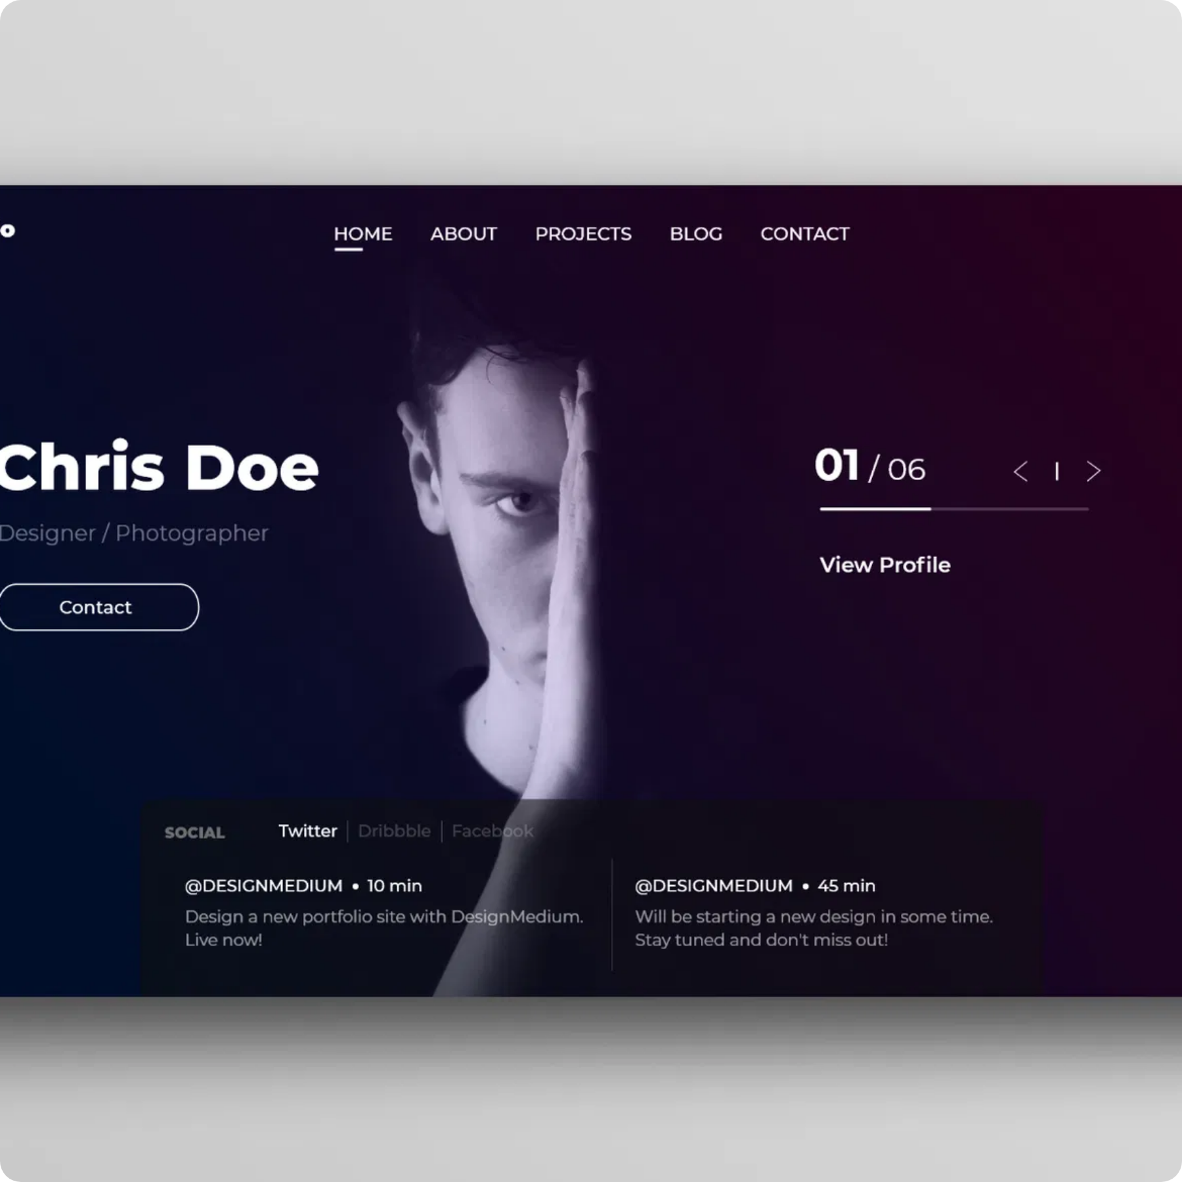
About the Developer
Abdallah Mohammed Elmahdy is a passionate full-stack developer with expertise in modern web technologies, mobile development, and database management.
Key Expertise Areas:
Frontend Development
Backend Development
Database Management
Mobile Development
UI/UX Design
Professional Background:
3+ years of professional development experience
50+ completed projects across various domains
Expertise in 10+ modern technologies
Specializes in creating scalable, efficient solutions
Education:
Bachelor of Computer Science with honors, specialized in software engineering and web development.
AE
Portfolio

Slide 3

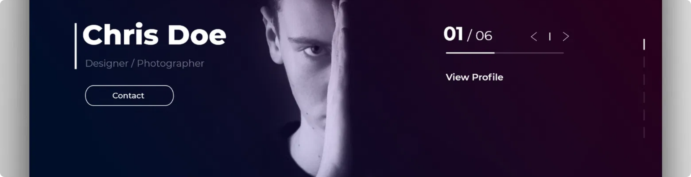


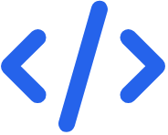
Application Overview
Purpose & Goals
Key Features
Technology Stack
A comprehensive portfolio application showcasing Abdallah's skills, projects, and professional experience to potential employers and clients.
Responsive design for all devices
React.js
Flask
Node.js
Light/dark mode toggle
User authentication system
MongoDB
MySQL
Tailwind CSS
Contact form with validation
JWT Auth
Project showcase with filtering
AE
Portfolio

Slide 4

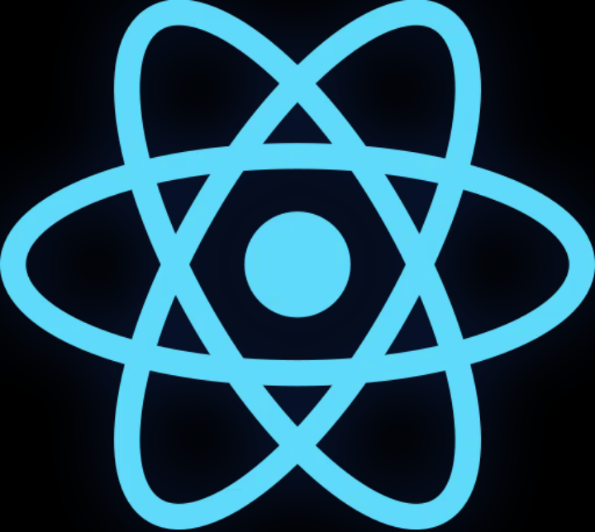


Frontend Technologies
React.js Implementation
Modern React application built with functional components and hooks. Leverages context API for state management and React Router for navigation.
UI/UX with Tailwind CSS
Utility-first CSS framework for rapid UI development. Custom components with consistent styling and modern design principles.
Light/Dark Mode Toggle
Theme context implementation with localStorage persistence. Smooth transitions between themes with CSS variables.
Responsive Design
Frontend Architecture
Mobile-first approach ensuring optimal display across all devices. Flexible layouts with Tailwind's responsive utilities.
Components (reusable UI elements)
Pages (route-specific views)
Contexts (state management)
Hooks (custom logic)
Utils (helper functions)
AE
Portfolio

Slide 5


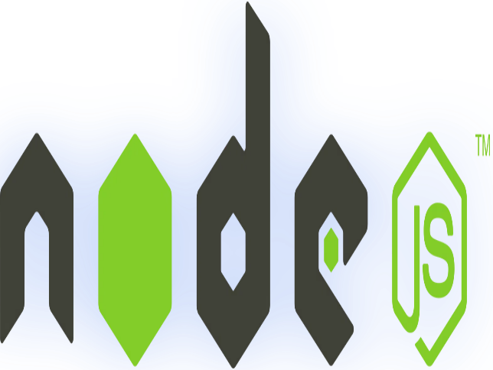



Backend Technologies
Flask API Architecture
RESTful API built with Flask framework providing secure endpoints for the frontend. Modular structure with blueprints for scalability.
Database Solutions
Dual database approach with MongoDB for flexible document storage and MySQL for relational data. SQLAlchemy ORM for database interactions.
Authentication System
JWT-based authentication with secure token management. Password hashing with bcrypt and role-based access control.
Backend Architecture
Key API Endpoints
API Layer (RESTful endpoints)
POST
/api/auth/register
Service Layer (business logic)
POST
/api/auth/login
Data Access Layer (ORM)
Database Layer (MongoDB/MySQL)
POST
/api/contact
GET
/api/portfolio/projects
AE
Portfolio

Slide 6


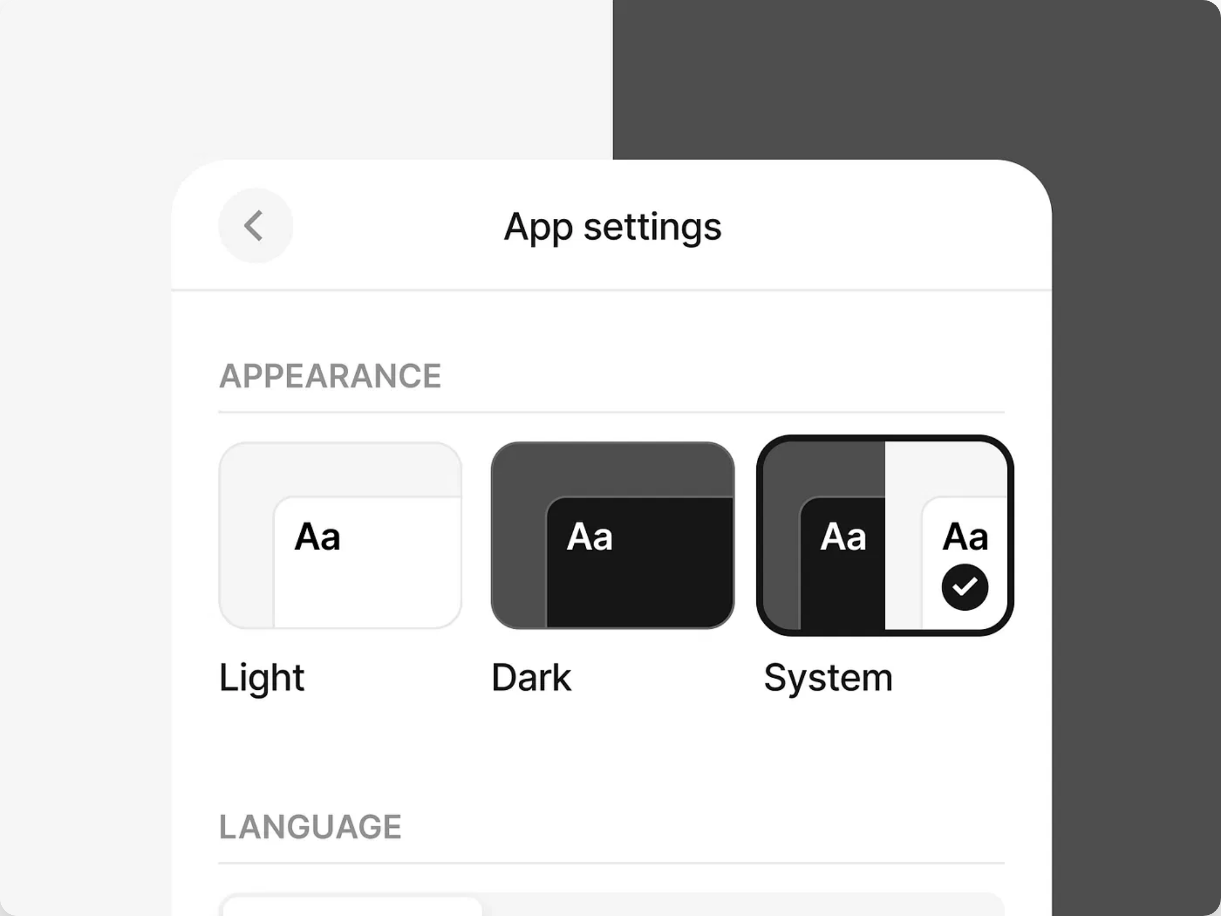




Key Features Showcase
Home Page
Modern hero section with animated elements, skills overview, and project highlights. Engaging call-to-action buttons for improved user experience.
Light/Dark Mode Toggle
Qualifications Page
Interactive skills showcase with categorized technology expertise. Professional experience timeline and education details with visual elements.
Contact Form
Fully functional contact form with real-time validation. Backend integration for message storage and email notifications. Success/error feedback for users.
Authentication System
Secure JWT-based authentication with login and signup functionality. Password hashing with bcrypt and protected routes for authorized access.
Light/Dark Mode
Seamless theme switching with persistent user preference. Carefully designed color schemes for both modes ensuring optimal readability and aesthetics.
The portfolio application features a seamless theme switching system that enhances user experience across all pages.
AE
Portfolio

Slide 7


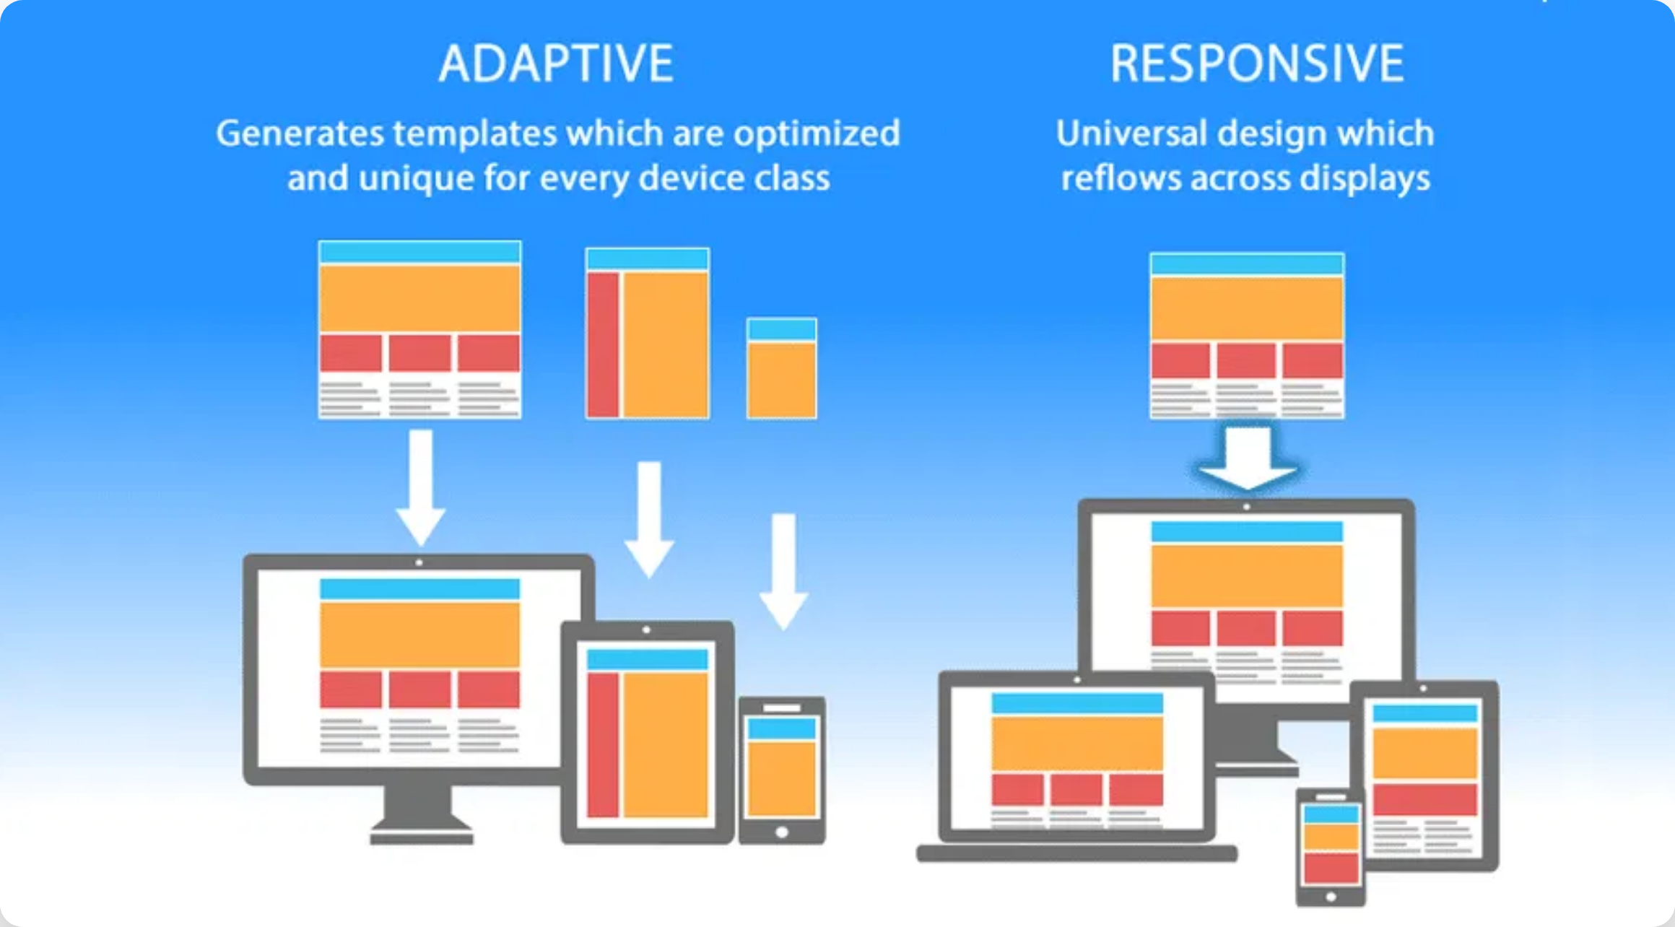


Technical Highlights
Code Quality & Organization
Responsive Design Implementation
Clean, modular code with consistent naming conventions and proper documentation. Component-based architecture for maximum reusability.
Mobile-first approach with Tailwind's responsive utilities. Flexible layouts that adapt to any screen size, from mobile devices to large desktop monitors.
// Example of clean component structure
const
ThemeToggle = () => {
const
{ theme, toggleTheme } =
useContext
(ThemeContext);
return
(
<button onClick={toggleTheme}>
{theme ===
'dark'
?
'☀️'
:
'🌙'
}
</button>
);
};
Performance Optimizations
Lazy loading of components, optimized bundle size, and efficient database queries. Proper caching strategies for improved load times.
Security Features
JWT authentication with secure token handling. Password hashing with bcrypt. Input validation and sanitization to prevent XSS and injection attacks.
AE
Portfolio

Slide 8

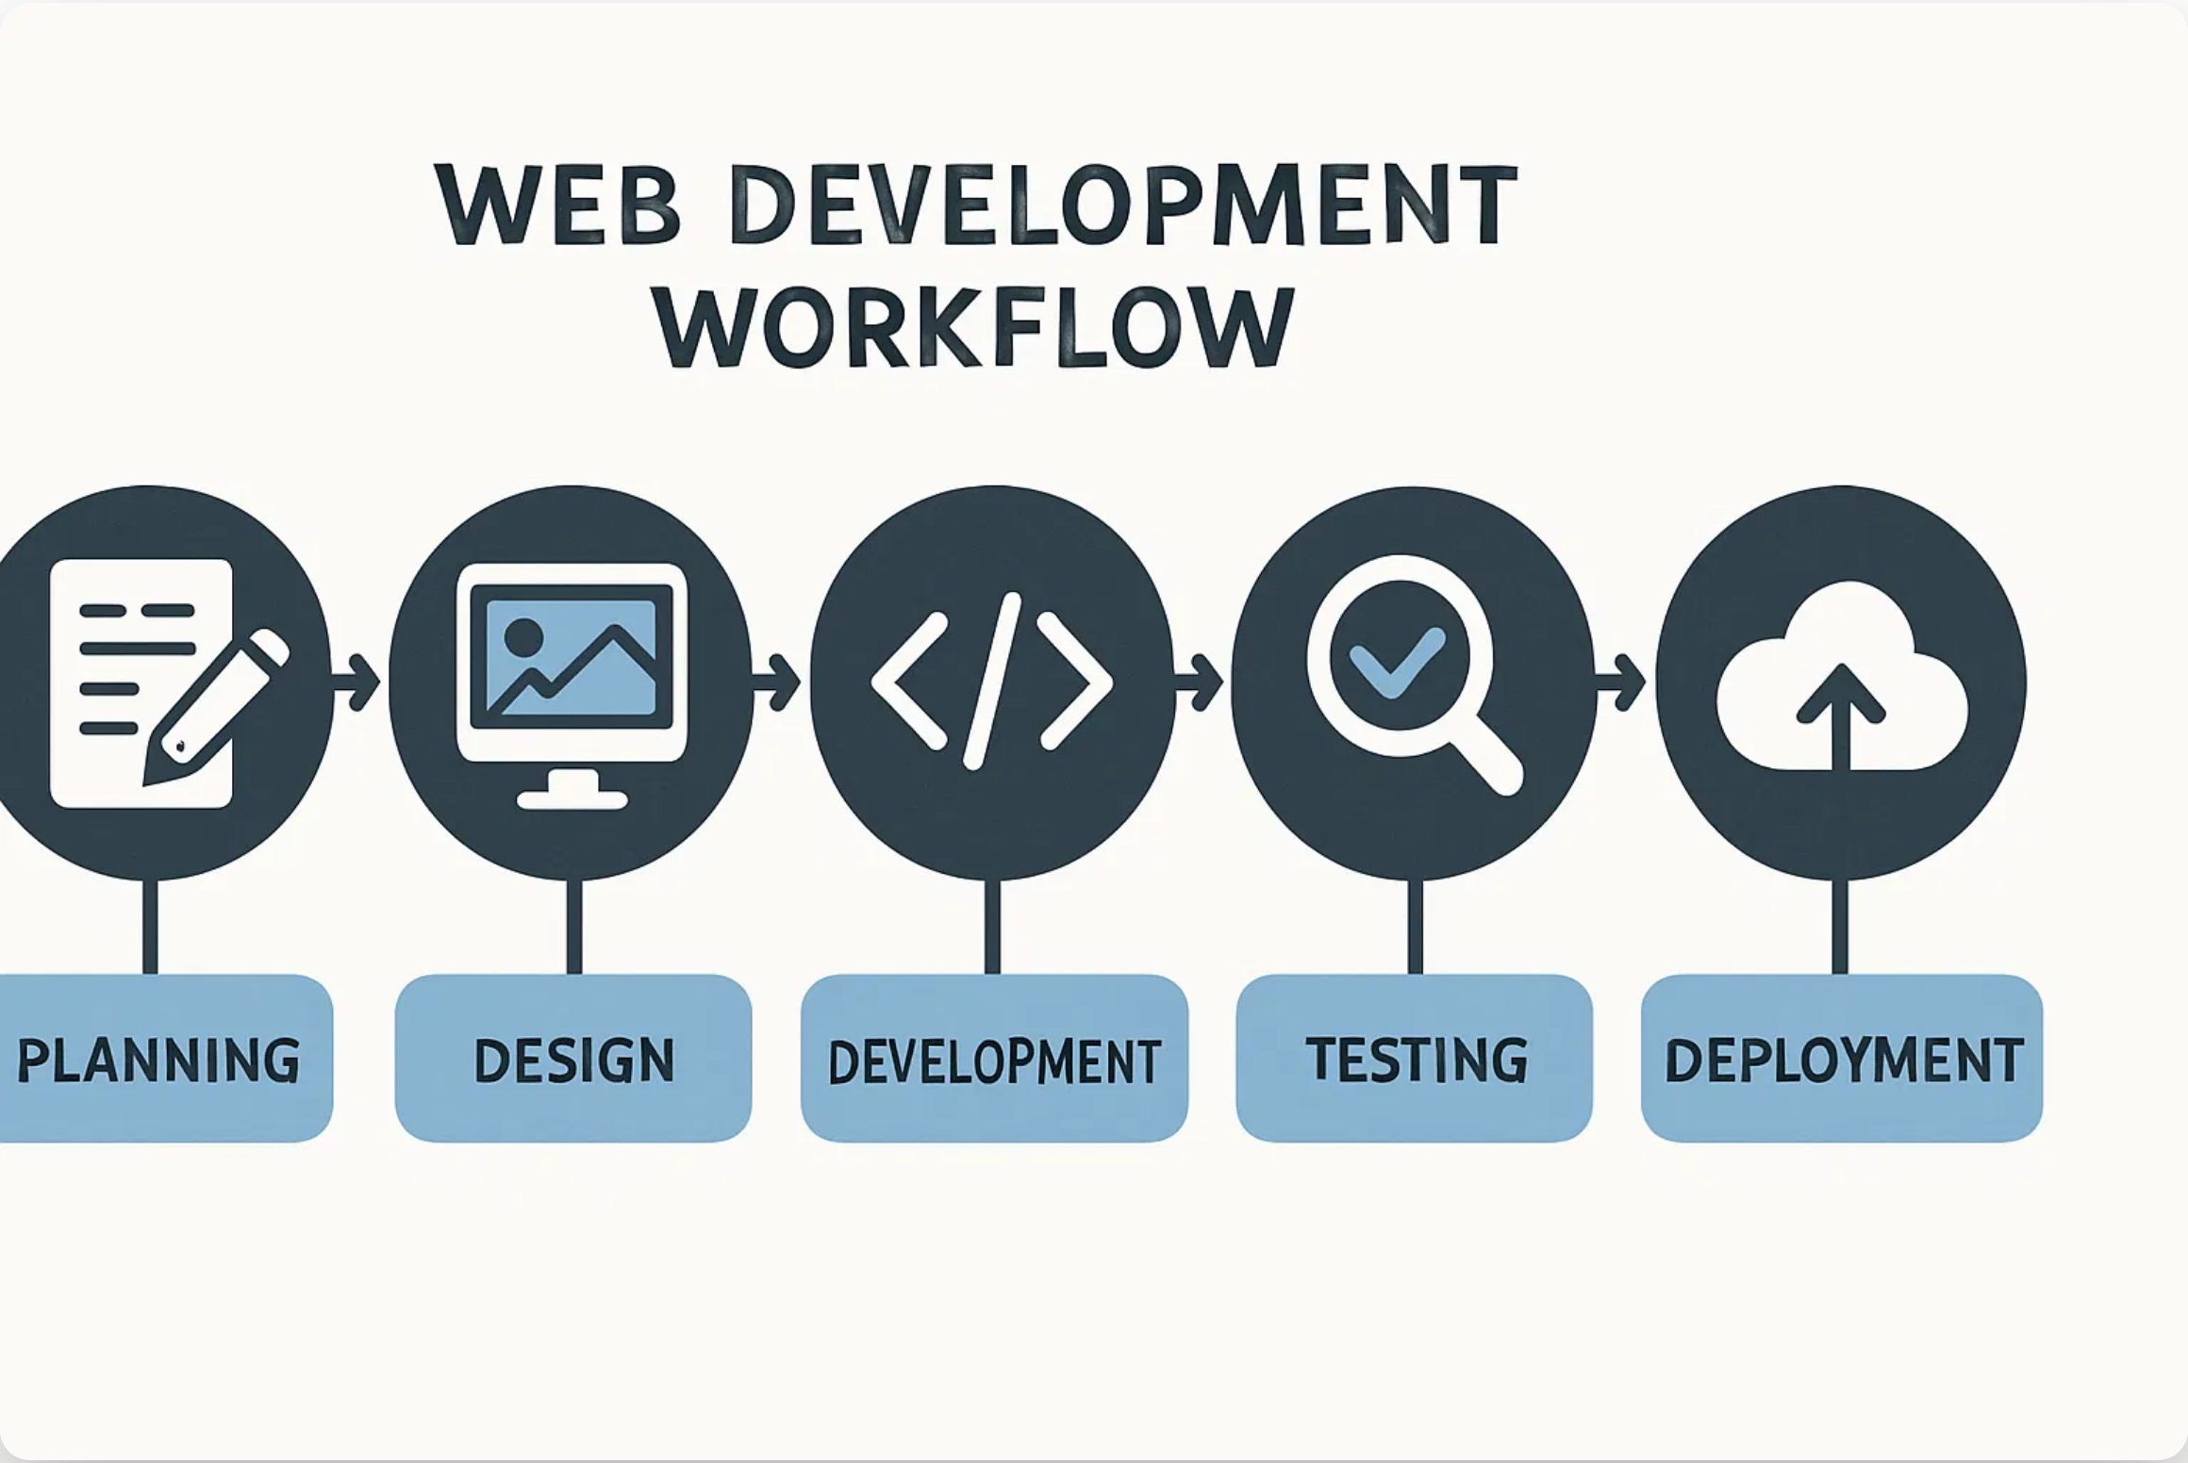

Development Process
The portfolio application was developed using an agile methodology with iterative development cycles and continuous feedback.
Methodology
Agile development approach with sprint planning, daily stand-ups, and regular reviews to ensure quality and timely delivery.
Tools & Practices
Version control with Git, CI/CD pipeline for automated testing and deployment, code reviews, and documentation.
Week 1
Requirements gathering and planning
Week 2
UI/UX design and prototyping
Key Achievements
Week 3-4
Completed development within planned timeline
Frontend and backend development
Successfully implemented all core features
Week 5
Optimized performance for all devices
Testing, refinement, and deployment
Achieved clean, maintainable code structure
AE
Portfolio

Slide 9

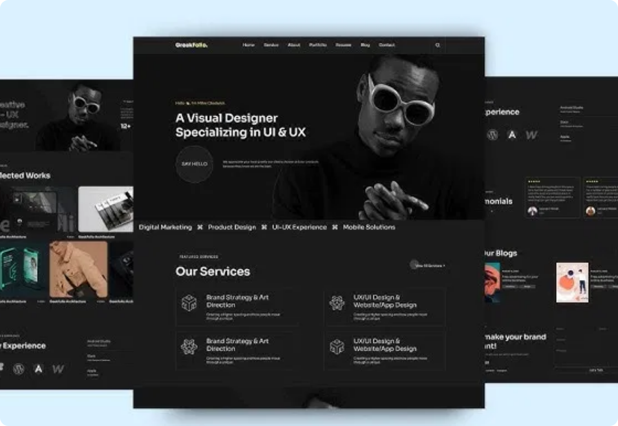


Demo & Results
Key Achievements
Fully Responsive Design
Perfect display across all device sizes
Complete Authentication System
Secure login, registration, and user profiles
Light/Dark Mode Toggle
Seamless theme switching with persistence
Working Contact Form
Form validation and backend integration
Page Load Speed
Lighthouse Score
0.8s
95+
Experience the live application
Visit Live Demo
AE
Portfolio
Demo credentials: demo@example.com / demo123

Slide 10








Contact Information
Email
abdallah.elmahdy@example.com
Phone
+1 (555) 123-4567
Location
Cairo, Egypt
Website
www.abdallahmelmahdy.com
Available for freelance projects and full-time opportunities
Let's Work Together
Interested in collaborating on a project? Looking for a skilled developer to join your team? Feel free to reach out to discuss opportunities.
AE
Portfolio

